Slide 1
Stock price prediction project
Tech Stack – Python, SQL
IDE – VS Code
Database – Bigquery
Datasets – TCS and Tech Mahindra (IT Sector)

Slide 2
Key terminologies
Volume – No of share trades within a day.
VWAP – Line which indicates shares prices are gonna rise or not.
Delieverable percentage volume - Percentage of total shares buyed by consumer as compared with the volume.
Executed – No of share buyed by buyer.
PE – indicator which indicates that the particular company is going to rise or not in future

Slide 3
CRUD operations
CREATE
1. Created the table based on our requirements.
2. Ensures that data types of inserted values match the defined types in the table schema.
READ
1. Read the data according to requirement to get the insights from it.
2. Retrieve historical stock price data from the database.
UPDATE
1. Modify existing historical stock price data in the database.
DELETE
Remove historical stock price data from the database.
Specifies the record to be deleted based on the primary key
Instead of hard deletion, mark records as deleted (e.g., with a deleted flag) for audit purposes.

Slide 4
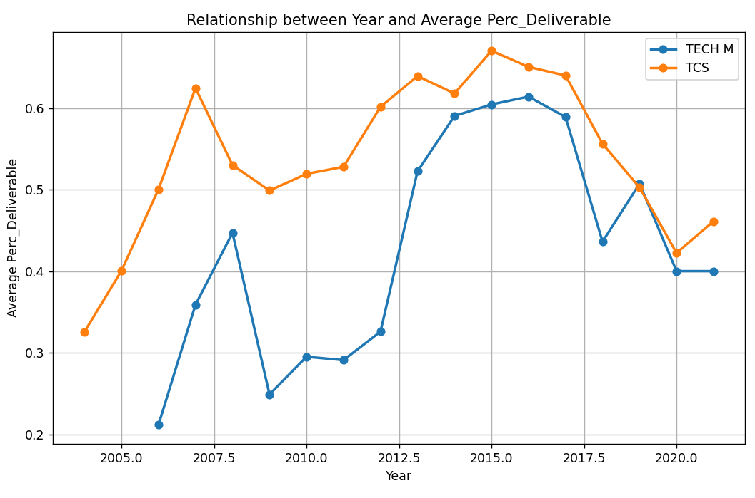
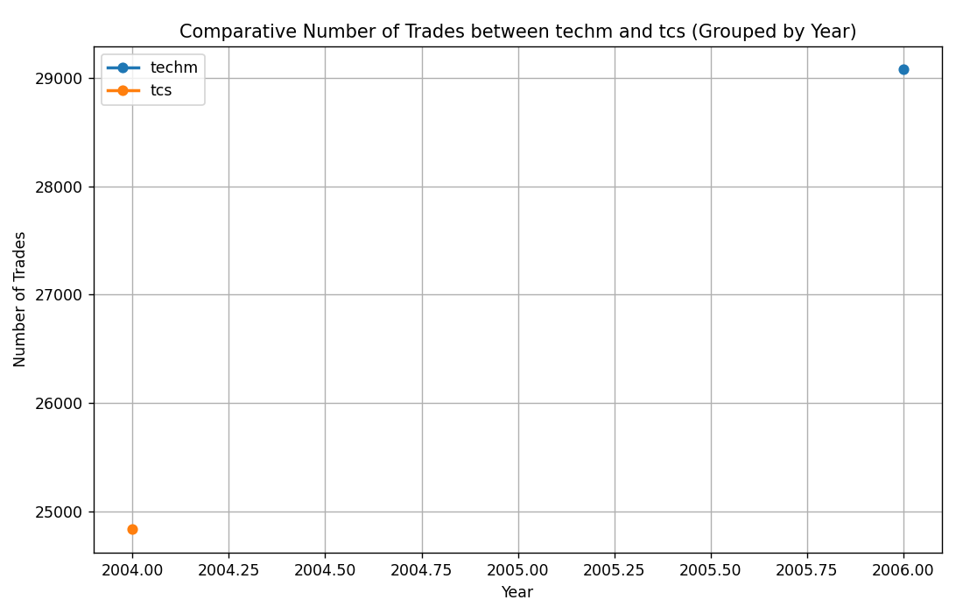
Key Findings / Insights from Data

Slide 5
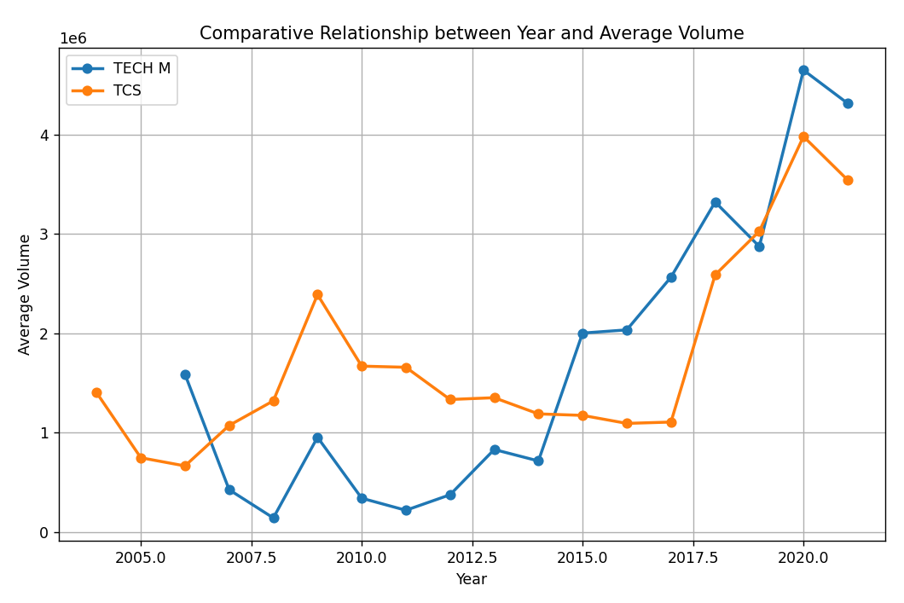
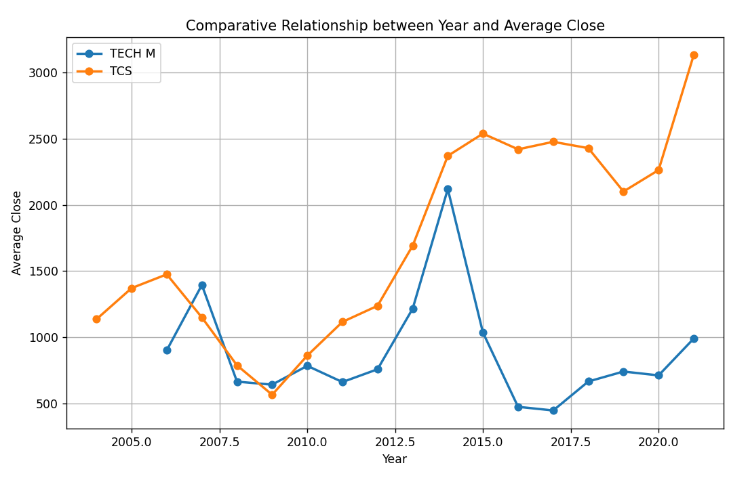

Slide 6
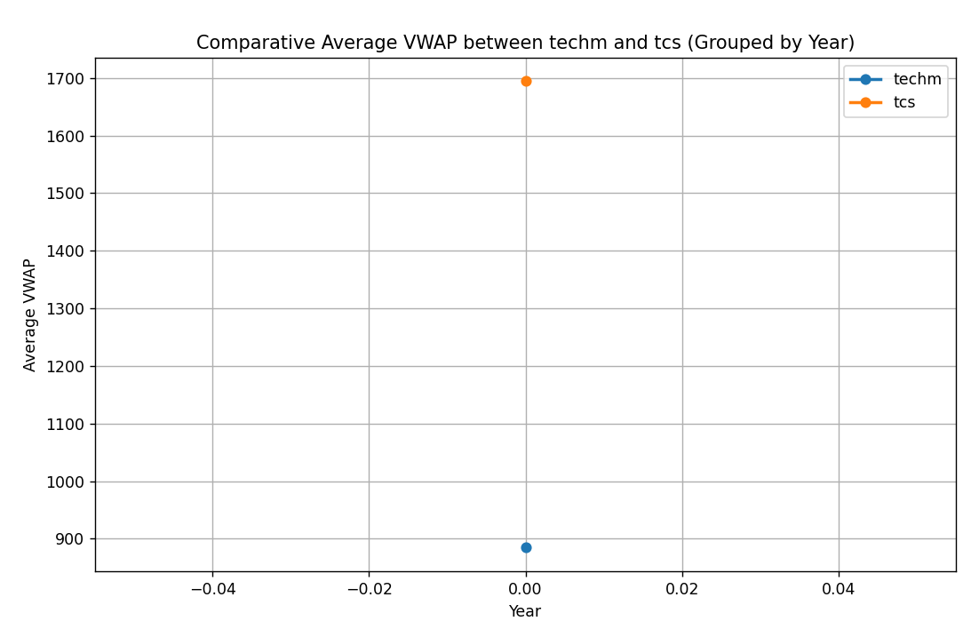
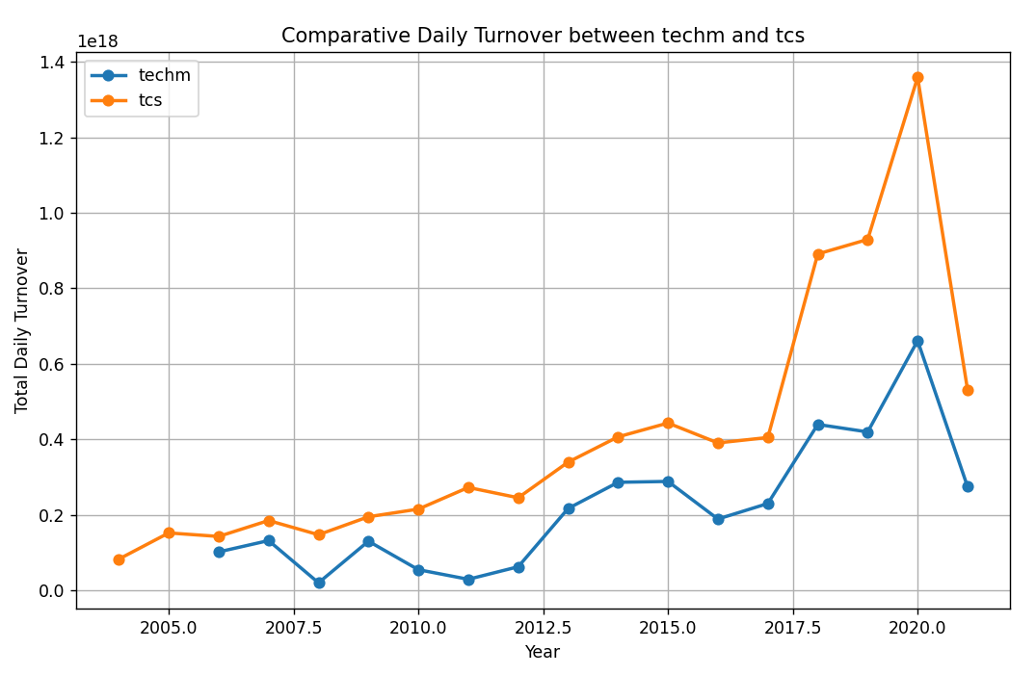

Slide 7
Future Scope
You can add data according to your need and do analysis on the data
Since we tested the various indicators in this project so you can apply the ML model according the requirement and gain the knowledge of the data which can be helpful for investment purpose.
Just by adding some HTML and CSS we can deploy our model as well so people can access the data.

